Slide 1
Dealing with Data 3: LAB
UIUC ECON 474 Econometrics of Policy Evaluation

Slide 2
Overview
Next time Mixtape subchapters:
Review: 2.7-2.16, 2.21-2.24
Read: 2.26, 2.27
Today:
Practice cleaning data
Practice combining data
Loading in large data

Slide 3
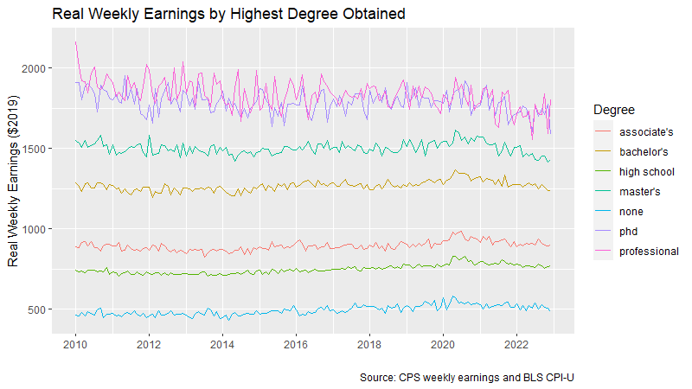
Replicate this figure and answer mystery question

Slide 4
Sources:
“DwD3 CPS degree earning 2010-2022.csv”
Current Population Survey: https://cps.ipums.org/cps/
“DwD3 CPI 2010-2022.xlsx”
Consumer Price Index (All Urban): https://www.bls.gov/cpi/data.htm
one-screen

